Slide 1



Welcome!
Please enter in the chat... ​
  Your name
  Your organization
  Your favorite children's book!
Please turn your cameras on and put your microphones on mute.
Notes:
Have this slide on in the background before the training begins. This gives everyone a chance to introduce themselves via chat. While this slide is on, there can be music playing in the background, if technology allows.
Note: This training is designed to be no more than 90 minutes. We encourage you to keep the training within this time if you are presenting virtually.
In-Person Tip:
If you are conducting the training in-person, you can replace this slide with a fun introductory activity! You can find some sample activities later in this deck.

Slide 2
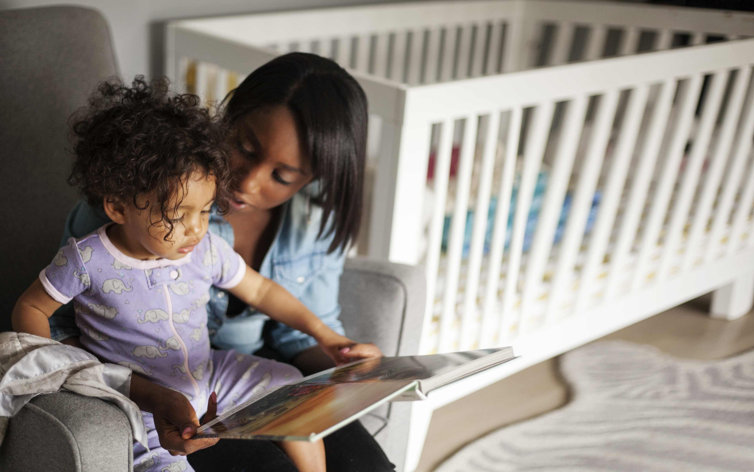
Talking is Teaching
Virtual Training for NAME OF VOLUNTEERS
TRAINER NAME
ORGANIZATION
Notes:
This is the beginning of the training. You can quickly flip through this slide, or take the time to introduce yourself/organization/background.

Slide 3

Welcome!
Thank you for your dedication to improving brain and language development in children ages birth to five in CITY!
You are part of a national community-based campaign called Talking is Teaching: Talk, Read, Sing

Slide 4
Housekeeping
Please keep your microphones on mute (unless speaking)
If possible, please turn your cameras on
If you have any questions, please put them into the chat
The training will be recorded

Slide 5


Today’s Objectives
Understand why trusted messengers are a critical part of the community campaign and the role you can play
Discover ways to build trust and create meaningful engagement with families
Learn tools and strategies to help parents understand the importance of building their child's early brain and language development

Slide 6
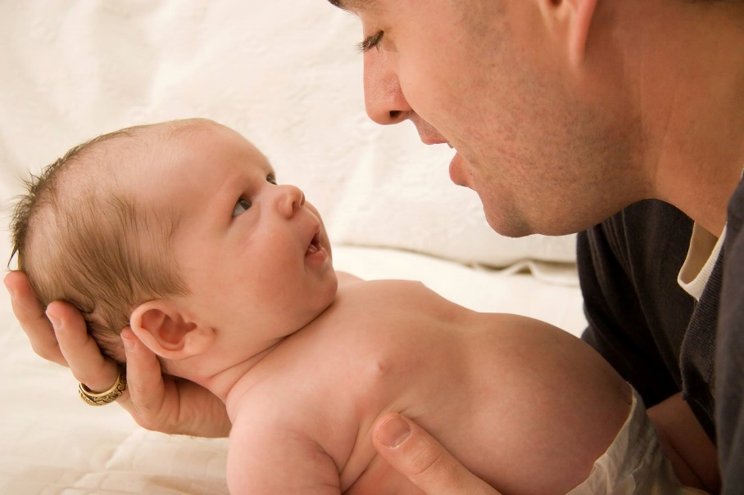
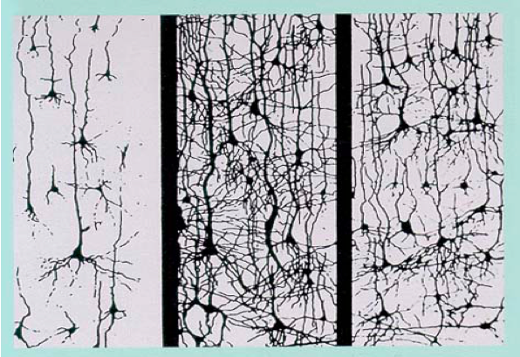

REASEARCH
The Opportunity
Neuroplasticity
At birth 6 years old 14 years old
90%
A child’s brain is already 90% developed by age 5
Drawing supplied by H.T. Chugani M.D., Chief, Division of Pediatric Neurology, Children's Hospital of Michigan
Notes:
Research shows that there is a tremendous opportunity to support brain and language development during early childhood. We know that 90% of a child’s brain is already developed by age 5. As such, those early years showcase a big opportunity to build the baby’s brain. Pointing this out to parents is not trying to induce panic like it’s too late, but to get some urgency and motivate to seize the opportunity.

Slide 7
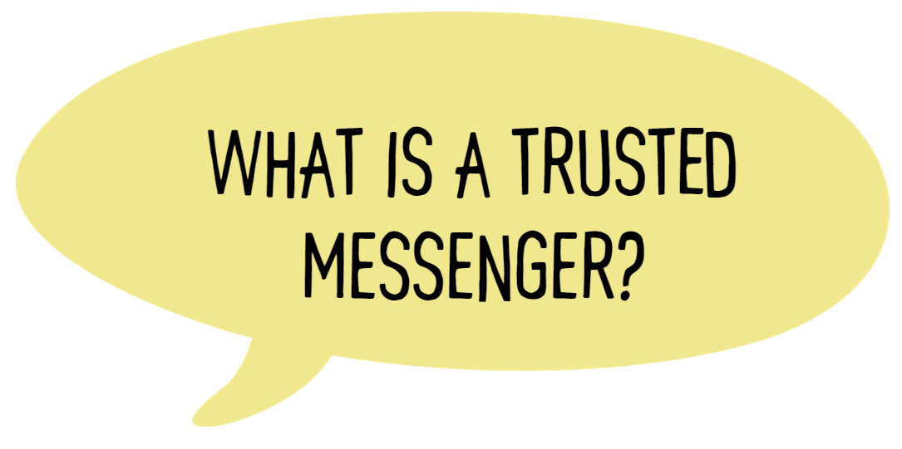


What is a trusted messenger?
Notes:
Note: We recommend choosing either slide 7 (a group discussion on what they think a trusted messenger is) OR slide 8 (a description on what a trusted messenger does/is). The first is more interactive, but will take some more time.
--------------------------
Now, as we get started today, we’d like you to tell us “What is a Trusted Messenger?” Who are the trusted people and/or messengers in your life?
People share aloud
Can be anyone – a parent, a laundromat attendant, a doctor, a teacher, a cashier – you do not have to pass a test to be able to become a trusted messenger.
The trusted messenger's role is not to dictate, but to listen to people to better understand their experiences in order to support them.
-------------------------
Great! Now, can anyone share what they think a “Talking is Teaching” trusted messenger would be?
People share aloud
The role of the trusted messenger is to share literacy messages and provide support and specific suggestions to families.
Trusted messengers let families know the power of their words and interactions with their children – they reinforce that parents have the power to support their child’s growing brain, building skills that will last a lifetime!
Trusted messengers are the ones who activate tools and resources, supporting and encouraging families in their journey as they raise their children.
Trusted messengers integrate their messages into the work that they’re already doing – a pediatrician would add early learning messages to a check-up, a restaurant server would add messages as they check on their guests
--------------------------
Finally, what do you think a trusted messenger would look like at their best?
People share aloud
Listens
Friendly
Asks clarifying questions
Do your best to remove bias - let go of everything you think you already know about the family you're working with.
Empathize and understand - put yourself in the shoes of the family.
Validate and encourage - make sure to validate the work and effort they have put in.
Willing to be vulnerable - speak about your own experiences as a caregiver or parent and share both the struggles and joys of parenting!

Slide 8

Your Role as a Trusted Messenger
You are in a unique position to share literacy messages and provide support and specific suggestions to families.
Let families know the power of their words and interactions with their children – they are supporting their child’s growing brain and building skills that will last a lifetime!
Your role is not to dictate, but to listen to families and understand their experience to meet them where they are.
Notes:
Now, what exactly is a trusted messenger? Trusted messengers play a large role in the Talking is Teaching campaign – your role is to share literacy messages and provide support and specific suggestions to families. Trusted messengers let families know the power of their words and interactions with their children – they reinforce that parents have the power to support their child’s growing brain, building skills that will last a lifetime! And importantly, the trusted messenger's role is not to dictate, but to listen to families and understand their experience to meet them where they are.

Slide 9
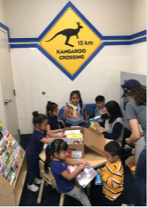
An Evidence Informed Approach
Notes:
So why are trusted messengers so important? In a recent research evaluation of our work in laundromats, conducted by New York University, Too Small to Fail found that trusted messengers can play a huge role in encouraging early learning. TSTF has, with Lakeshore Learning and Scholastic, created “Family Read, Play & Learn” kits, which are literacy spaces that can be added to waiting areas such as laundromats. These spaces are great at encouraging literacy-related activities. However, they found that when there was a trusted messenger present who activated the space, such as a librarian, children and parents’ time spent in the space increased.
The average amount of time spent by children in the literacy space during librarian visits was 47 minutes, significantly more than the 29 minutes on average that children spent alone in the space.

Slide 10
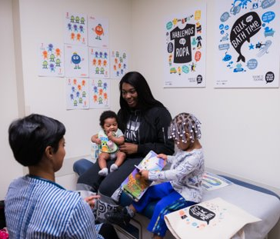
An Evidence Informed Approach
Notes:
In a separate evaluation of TSTF’s work with trusted messengers in the healthcare setting at the Zuckerberg San Francisco General Hospital, they found that when doctors provided families with both a tote bag filled with resources, as well as messaging on the importance of talking, reading, and singing, it left a big impact on the families! 8-12 weeks after the family’s visit with the pediatrician, 99% of parents who participated in the follow-up interview said they remembered talking with their doctor about the importance of talking, reading and singing with their child. Most importantly, 84% of parents reported that they noticed a change in their child’s behavior since receiving the Talking is Teaching toolkit from the trusted messenger, such as their child talking more, being more interactive, and reading more.
Throughout both of the mentioned evaluations, we see that while resources and tools are great, it is the trusted messenger that makes the biggest impact. When a parent, doctor, librarian, laundromat attendant, or cashier speaks with the family, builds trust with them, understands them and supports them, that’s where the “magic” happens.

Slide 11
Traditional Practice
Appreciative Practice
vs.
Focus on What’s Wrong
Focus on What’s Right / What Can Be
Past Focus
Future Focus
Problem Focus
Solution Focus
Focus on Failure
Focus on Success
Looking for Problems
Looking for Possibilities
Placing blame
Thinking and encouraging
about how to improve
Notes:
So now that we’ve talked about what trusted messengers are and why they’re important, I want to briefly talk about a concept that should be a guiding principle for us as trusted messengers: appreciative practice. This means focusing on what’s right or what can be, rather than focusing on what’s wrong. There’s emphasis on the future rather than the past, as well as a focus on solutions and success rather than problems and failure. Trusted messengers should look for possibilities rather than look for problems, as well as think and encourage improvement rather than place blame.
Here, we move away from traditional practice and towards appreciative practice – something important for a trusted messenger to do, especially because – as we mentioned earlier – trusted messengers are not dictating or lecturing to parents, but are rather supporting them with early learning messages and tools.

Slide 12
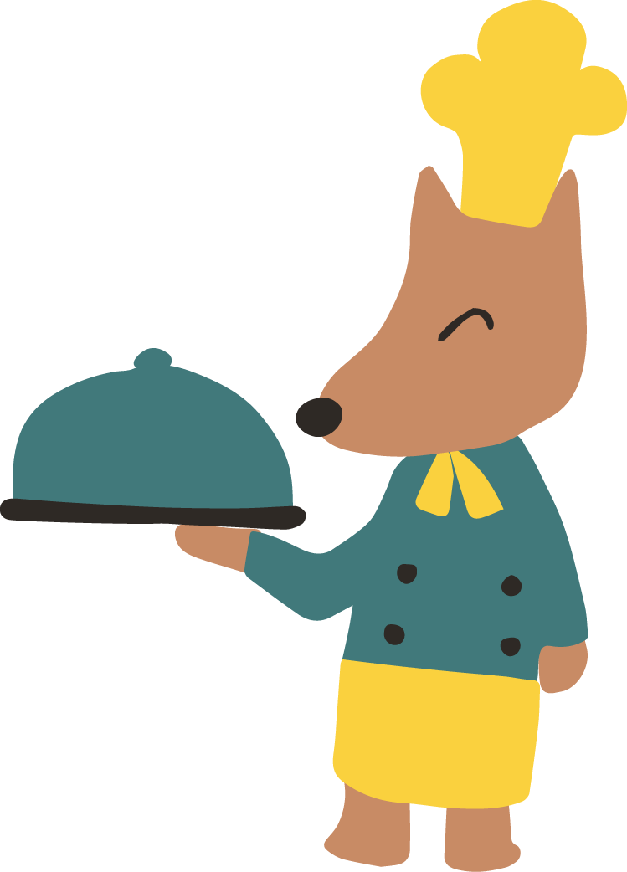
In the Chat…
When are there opportunities for families to talk, read, and sing together every day?
Notes:
I’d now love to take a moment to think about where there are opportunities for families to talk, read, and sing together every day in your community. What part of a caregiver's daily routine could be integrated with talking, reading, and singing? Please put your thoughts in the chat!
Talk about the ideas that participants put into the chat.
So as you can see, there are many ways to talk, read, and sing everyday! This is a little preview of one of our key messages: everyday moments can be a meaningful learning opportunity!

Slide 13
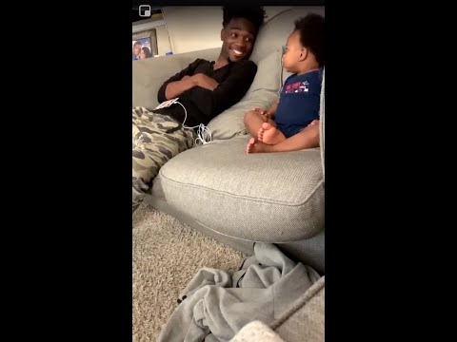
Talking together during TV time!
Notes:
For those of you who learn from "seeing", here is a great example of how a family integrates talking into an everyday activity – watching TV! This moment is turned into a rich learning moment for the baby, who has a back-and-forth "conversation" with his dad. Even though the baby is not saying actual words, his father turns TV time into an opportunity for talking, which helps to increase his little one's vocabulary and brain development, while also creating a precious and heartwarming memory!

Slide 14
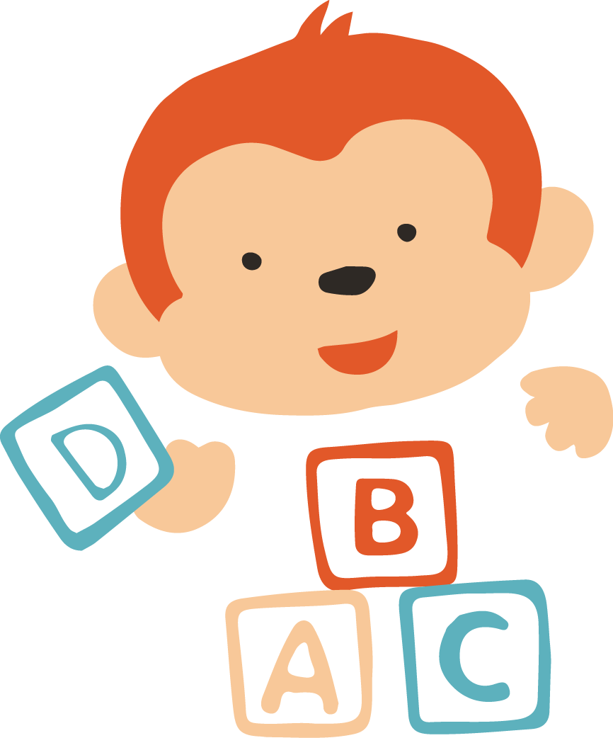

Messenger Tips 101
Adults learn best when:
  Their experiences and knowledge are recognized and built upon
  They are provided opportunities to practice new learning
  Connections are made between theory and practice
  Feedback is strength-based, reinforcing what someone is doing well
Notes:
As we think about messaging, a good place to start is with some helpful basics on how adults learn best. You all probably know some tips on how children learn best, but when you're interacting with a parent or caregiver, here are some tips on ways that you can best support them.
Parents and caregivers learn best when:
Their experiences and knowledge are recognized and built upon
They are provided opportunities to practice new learning
Connections are made between theory and practice
Feedback is strength-based, reinforcing what someone is doing well

Slide 15

Key Messages for Families
Try to do one or more of the following!
Talking, reading, and singing from birth will help build a child's young brain and help prepare a child for kindergarten.
Reading aloud to children has many benefits! It promotes physical contact, it can help spark imagination, it builds language and reading skills, it motivates children to love books, and it even increases attention span and memory!
You are your baby's first teacher! You're the expert in your baby's life, and even the simple things you do each day (like talking together) is meaningful and impactful!
https://www2.ed.gov/documents/early-learning/talk-read-sing/bilingual-en.pdf
Notes:
As for key messages for families, we're focused today on delivering messages to parents on early brain and language development. From our perspective, here are some key points to touch on with families. Try to do one or more of the following during your visits or interactions with families!

Slide 16

Key Messages for Families
Try to do one or more of the following!
Any moment into a meaningful learning opportunity.
Encourage bilingualism! Children who learn more than one language have more active and flexible brains. Try a picture walk!
Every child develops at their own pace. Meet your child where they are!
Acknowledge families' strengths.
https://www2.ed.gov/documents/early-learning/talk-read-sing/bilingual-en.pdf
Notes:
Here are a few other key messages we encourage you to share with families.
TRAINER NOTE: Please feel free to add to these key messages, especially if your training is on a specific topic (like math or social-emotional development). For your convenience, you can find additional key messages on these topics in the optional slides section at the end of this deck.

Slide 17
Trusted Messengers in Action
Notes:
OPTIONAL – If you have a video of trusted messengers "in action" in your community or testimonials from families who have already interacted with trusted messengers in your community, we encourage you to add it to this slide. After showing it, make a few remarks on the impact that trusted messengers have already played in your community! You can also use the video as an opportunity to ask participants to think about how the trusted messenger speaks to the caregiver. What do they say or do that helps foster trust? What key messages do they share, and how do they share them? What do you think is good about their approach, and is there anything that could be improved?
If you do not have any videos or testimonials, you can use the trusted messenger video TSTF created: https://www.youtube.com/watch?v=GU5RYBFXuYM. As with above, try to incorporate a discussion after showing the video.

Slide 18
[CITY's] Trusted Messengers
How have you engaged with families previously as part of your everyday workflow?
What was that like?
Notes:
Now, what about you all: the soon-to-be trusted messengers in [CITY]? What might an interaction look like for you, and where might there be opportunities to talk, read, and sing in the spaces you are in?
Before I dive into the example, I would love to ask you all: have you engaged with families previously as part of your everyday workflow? What was that like?
Ask for 2-3 people to share what they have done.

Slide 19
[CITY's] Trusted Messengers
TYPE OF TRUSTED MESSENGER
TIP: ACTIONS TYPE OF TRUSTED MESSENGER CAN TAKE
Example: EXAMPLE OF THE ACTION
If possible, get a video of the trusted messenger interaction occurring.
Notes:
Thank you for sharing! Those are wonderful examples – as you can see, there is no one way that you can support families. However, for those of you who might be new to the idea of being a trusted messenger, here are some additional tips that you can consider integrating into your own everyday work, as well as an example of how other trusted messengers in your role as [ROLE] have engaged with families.
NOTE: A more engaging way to do this activity is to ask participants how they could see themselves integrating the key messages/resources into their everyday workflow. It can be helpful for the trainer to provide examples of what has worked in the past, but it’s best to avoid being too prescriptive! If possible, get a video of the trusted messenger interaction occurring.

Slide 20

Your tools
INSERT PHOTOS OF TOOLS
Notes:
Speaking of tools, these are the materials that families will be receiving. As you may know, the Talking is Teaching community in CITY will be delivering MATERIALS to families in the local community.
In total, families will be receiving # items: a [LIST MATERIALS]
Let's do a deeper dive of the resources. You'll notice that the DEEP DIVE INTO MATERIALS. Include what the materials are, and how you can activate these materials with families. [For some examples and inspiration on how to activate specific materials and tools, see the sample talking points tip sheet that was sent to you after the training.]
Depending on how many resources you are distributing, you may need to add more slides for a deeper dive into each resource. Additionally, we recommend asking participants to share their own ideas on how they would model specific materials.
In-Person Tip:
If you are conducting the training in-person, there is a lot more opportunity for a hands-on experience! Try to have the tools ready for the training and give each participant a set of the tools. As you model the tools, you can ask participants to share ways that they might model the tool with a family.

Slide 21
Activity
Notes:
Note: We recommend that you do an activity during your training. Activity type will depend largely on what your training looks like (in person vs virtual, number of people you are training, how long your training is, etc.). The goal of any activity is to allow the trainees a chance to think more critically about what it might look like to share a key message and resource with a family.
Try out different activities and see how it goes! Our biggest successes in activities have been when we rely on the trainee to tell us how they might integrate the message and resource: this could look like an idea-generating session (sticky notes on a real or virtual whiteboard or a group discussion), or modeling activities where trainees group up and test out how they might say the message in their everyday conversation.

Slide 22
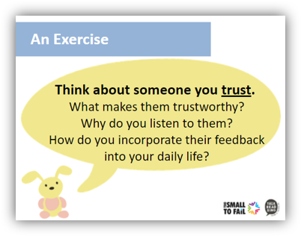
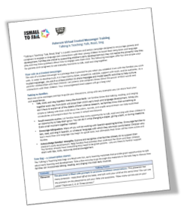
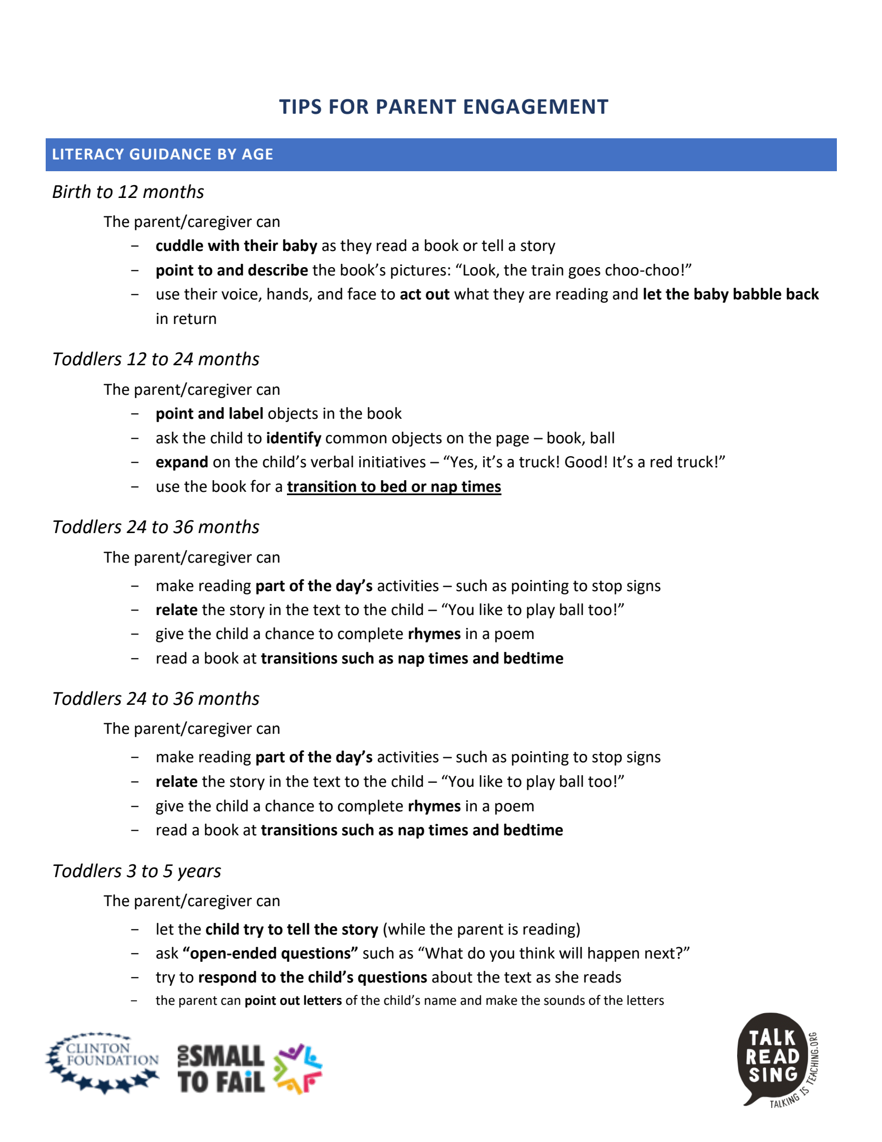
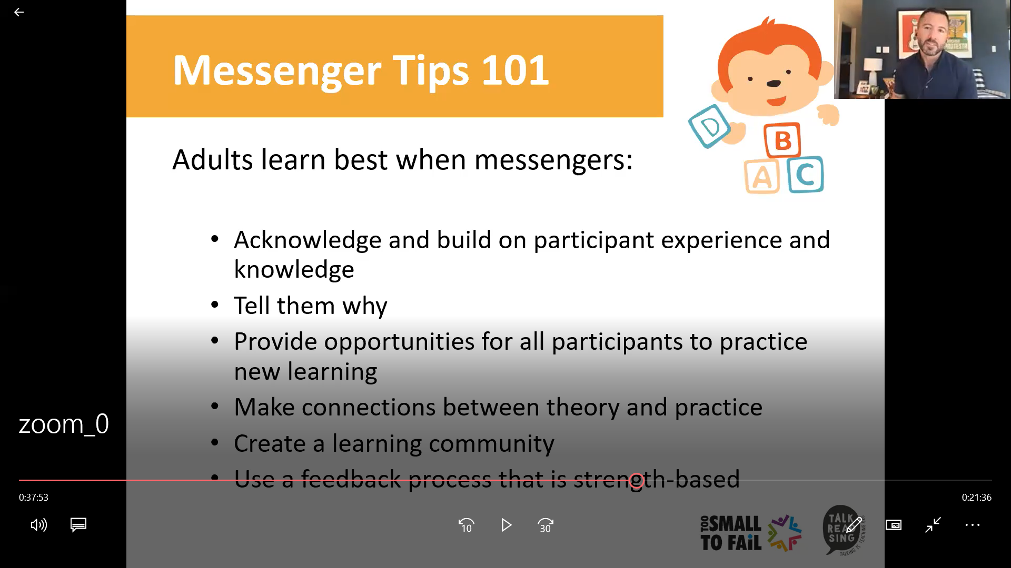
Your Resources and Materials
Notes:
We encourage you to provide trainees with a recording (if applicable) and other takeaway items. If you are asking them to share some specific messages and resources, a document detailing those is very helpful.

Slide 23


Closing Activity
What is one thing you've learned today?
What are one or two things you will take back and begin implementing right away?
Notes:
As we wrap up today’s training, I’d love to do one last activity. What is one thing that you learned today, and what is one thing you will take with you and begin implementing right away? Please put your answer in the chat!
Note: If your training is in-person, you can modify this closing activity to be more hands-on. Please see the slides near the end of the deck for a detailed description of what this could look like.

Slide 24
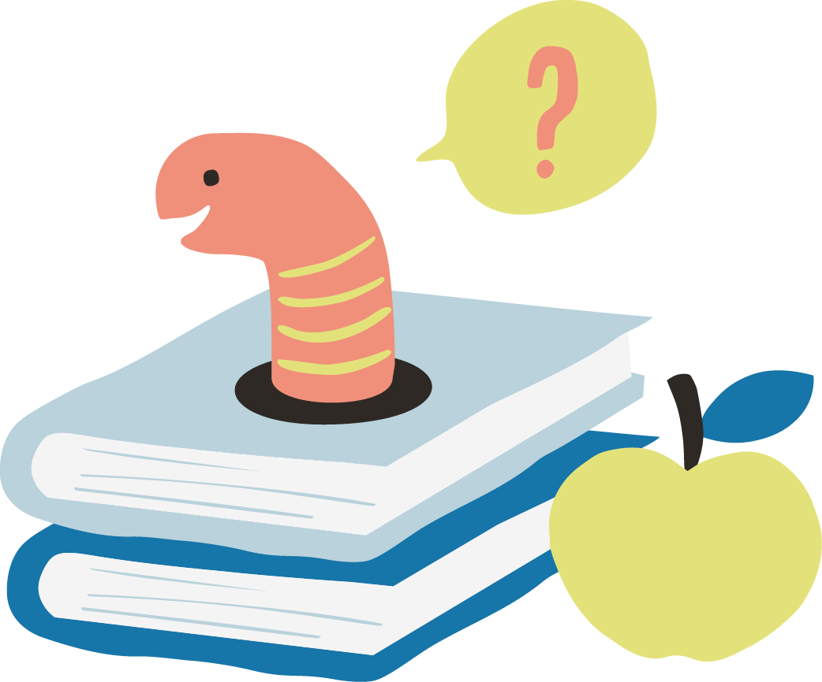

Questions?
Notes:
Trainer: Now, we have some time to answer questions that came up in the chat during the training. If you have a question but did not enter it in the chat, please raise your hand or click the "raise hand" button!

Slide 25


Thank You!
Please click on the link to a post-training survey (in the chat). We appreciate all feedback!
I will be emailing everyone shortly with the survey and tip sheets on parent engagement.
You will also receive a Certificate of Completion. Thank you for joining us in this virtual training!
Notes:
Thank you everyone for attending this virtual training! I will be putting a link to a short post-training survey in the chat, and I will also be emailing everyone the tip sheets and the link to the post-training survey. We appreciate all feedback as we think about how to further improve on our trainings in a virtual environment. Thank you for helping improve brain and language development in young children in [CITY]!
[NOTE: Please feel free to use the same format as the survey you took during your training. We also encourage you to adapt the survey to the needs and characteristics of your community.]
Finally, you will also receive a Certificate of Completion. Again, thank you for joining us in this virtual training! I will be sticking around for a few more minutes to address any additional questions you may have, but the training is officially over!

Slide 26
THANK YOU!
Have questions?
Please contact [NAME] at EMAIL

Slide 27
Optional Slides
Notes:
NOTE: The following two slides are optional and include slides on building trust, basics of early brain/language development, and tips for a virtual environment. Should any of these slides be applicable to the training you will be conducting, please feel free to add them to the main deck.

Slide 28
Optional Slides:
Talking is Teaching Info
Notes:
If you think that the trusted messengers would benefit from learning more about Talking is Teaching (especially if the participants are brand new to the campaign), it might be helpful to add information on Too Small to Fail and Talking is Teaching. You can insert the following slides into the deck. You could also add a slide on your campaign and what you do locally!

Slide 29
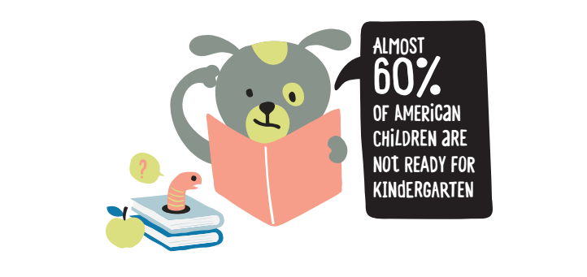

The Issue
If every child is too small to fail…
Then why are so many children not ready for school?

Slide 30
Making Small Moments Big

Slide 31
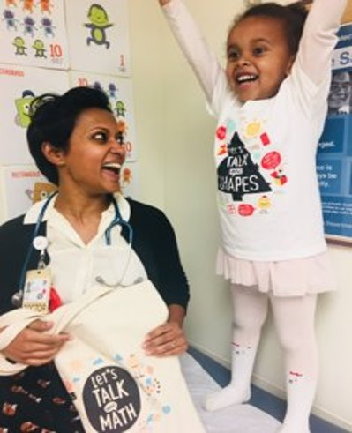
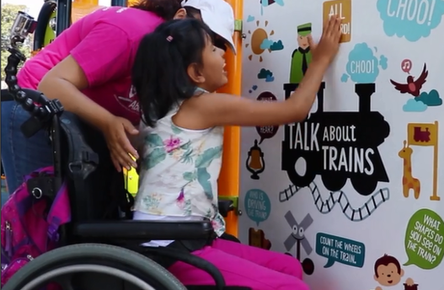
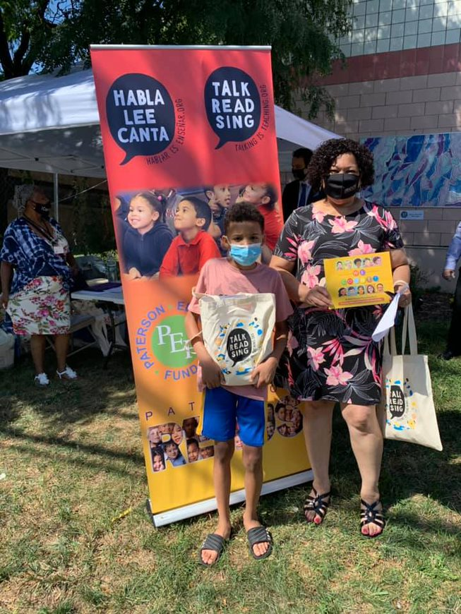
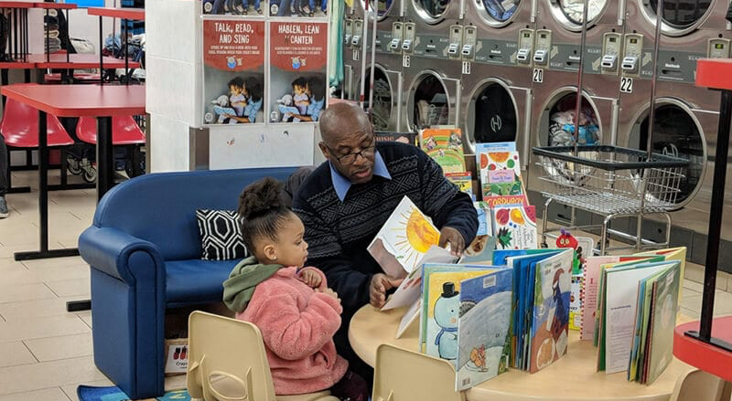
Too Small to Fail's Three Key Strategies
People
Places
Resources
Notes:
In order to make small moments big, TSTF developed three central strategies in which we do our work: people, places, and resources.

Slide 32
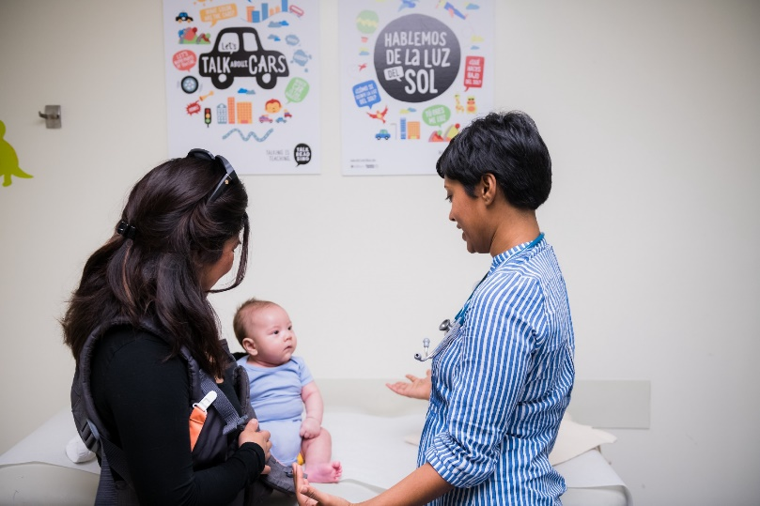
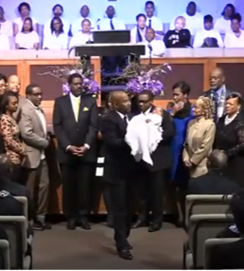
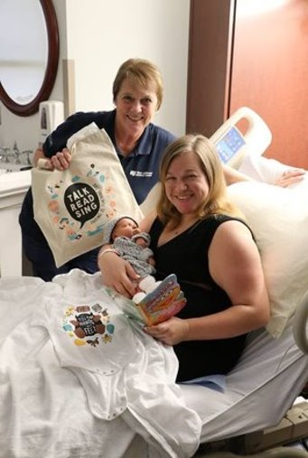
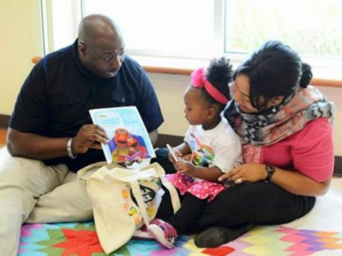
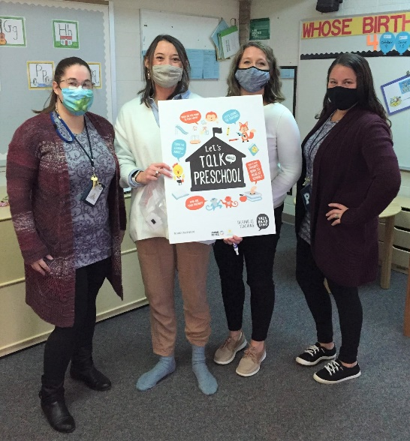
Trusted Messengers
Notes:
The first strategy (and the core of this training) is the work with trusted messengers. Who is it that parents/caregivers/families want to hear from, who do they trust, and who are they most likely to hear early learning messages from? And then, how can those people then share early learning messages to help families support their child’s young brain?
If you elect to talk about TSTF’s and your campaign’s three key strategies, this slide is an opportunity for you to give a brief overview of who you’ve trained as trusted messengers in the past, and showcase a few examples of what those partnerships looked like.

Slide 33

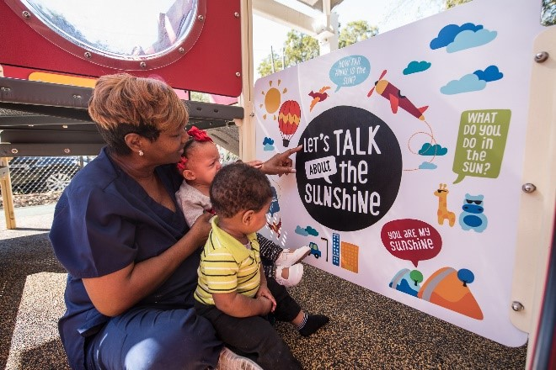
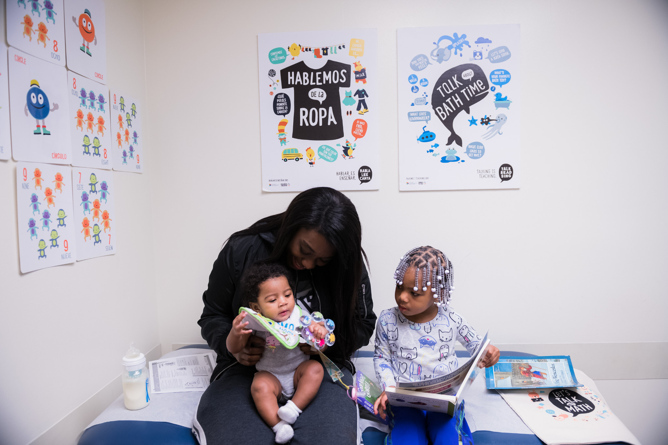
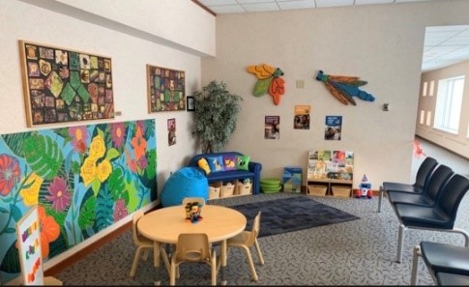
Places: Transforming Everyday Spaces
Notes:
The second strategy is focused on meeting families where they are with that early messaging – specifically, transforming everyday spaces. We know that parenting is a lot of work, so we want to make sure that our strategies meet families in the spaces where they may already be going with their young children. As you all know, some of these transformed spaces include laundromats, pediatric offices, social service agencies, libraries, playgrounds, transit, and other everyday spaces.
For your own trusted messengers, this slide gives you an opportunity to briefly talk about what specific spaces you’ve transformed

Slide 34
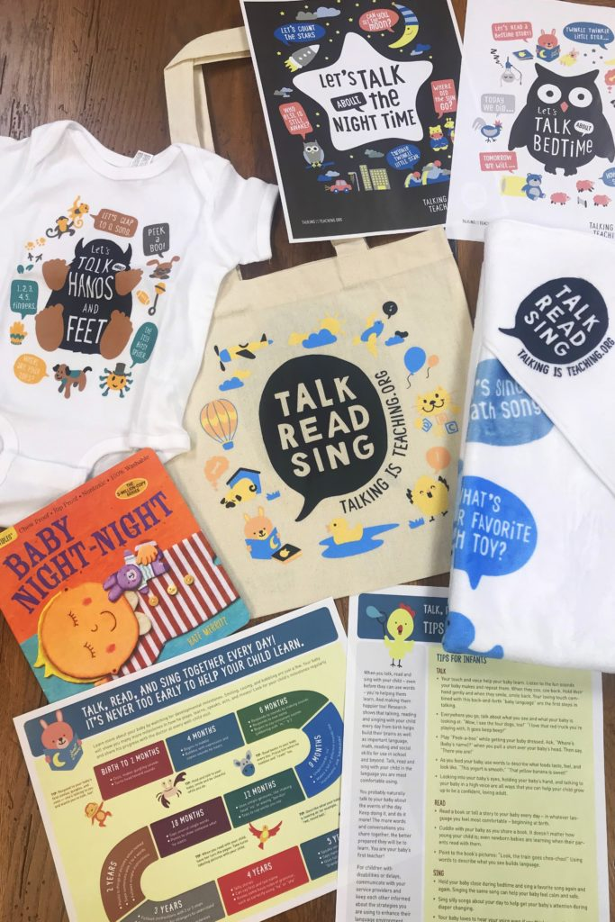
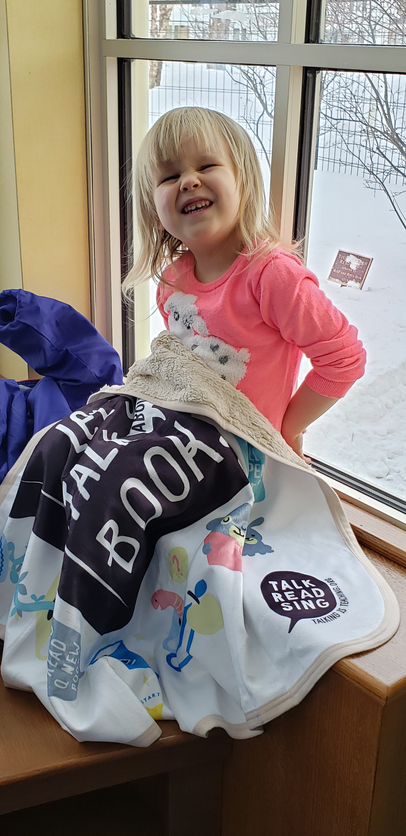
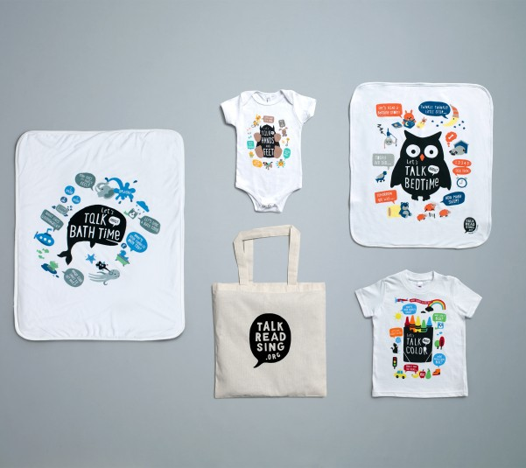
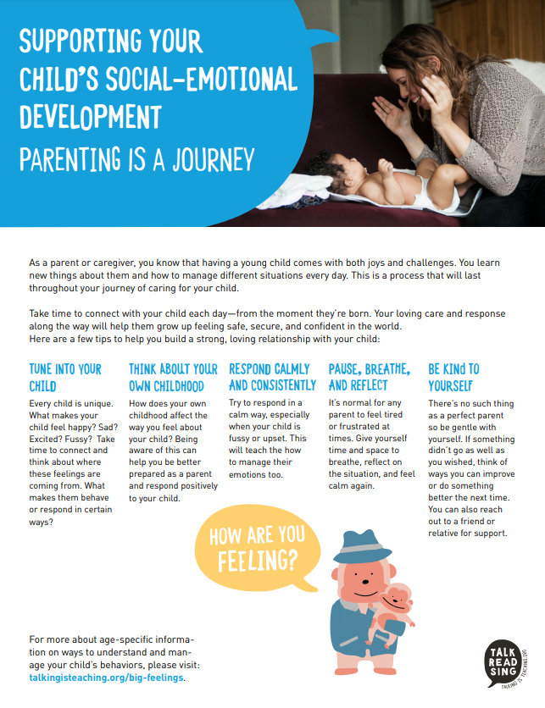
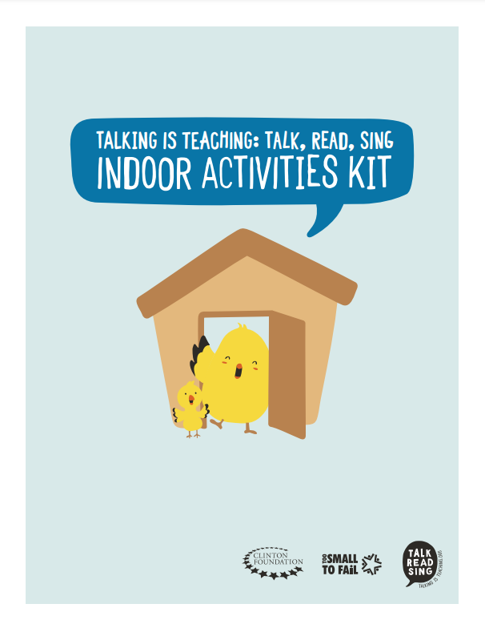
Resources
Notes:
Finally, we have the third key strategy: resources. We want families to see early learning messages out in their community, and we want them to engage with a trusted messenger on those same messages. However, we also want to make sure that families have resources to take home – whether those are books, tip sheets, or textile materials like onesies or bibs that have early learning prompts on them.
As with the prior two slides, this slide gives you another opportunity to show photos of prior tote bags and distribution, with perhaps a testimonial or two from what you may have heard from parents and caregivers who received the materials.

Slide 35
Optional Slides:
Building Trust
Notes:
You can use the following slides if you want to dive deeper into steps for building trust. These slides also break down the etymology of trusted messenger into “trust” and “message”. It also includes a slide with a longer definition on what it means to be a trusted messenger. You could add these slides if you think that the trusted messengers do not already have extensive experience with relationship building with families. For example, a family court judge may benefit from a review on ways to build trust, particularly given the space they work in and the power dynamics at play.

Slide 36
An Exercise
Think about someone you trust.
What makes them trustworthy?
Why do you listen to them?
How do you incorporate their feedback into your daily life?
Notes:
Trainer: Now, as we get started today, I'd like everybody to think about a person you trust. Ask yourself:
1. What makes them trustworthy?
2. Why do you listen to them?
3. How do you incorporate their feedback into your daily life?
Visualize this person in your mind, the emotions you feel when you're around them, and why.
Trainer (after ~30 sec have passed): I'll go first. The person I trust the most is ____________

Slide 37

Breakout Rooms!
You will now be placed into breakout rooms of 2-3, for three minutes total.
With your partner, share a story about who you trust and why.
Notes:
Now, we're going to break you all up into breakout rooms of 2-3, for three minutes. While you are in your breakout rooms, I want everyone to share a short story about who you trust and why. We know that it can be difficult and sometimes uncomfortable to join breakout groups, so we invite everyone to be gentle with one another during activities – this is a space of compassion. Additionally, these breakout rooms will not be recorded, and anything shared will remain confidential. When we come back together, it would be great if we heard from some of you on how the breakout room went, but please only share if you feel comfortable doing so.
[START BREAKOUT ROOMS – 3 MIN]
After the breakout rooms...
Have 1-2 participants share their story
Trainer: Thank you for participating in this activity. I know it might have felt a little strange to be vulnerable to people who may be complete strangers. But the most important part of being a trusted messenger is to be open, authentic, and willing to share your experiences with others. By being authentic, you will be able to create meaningful connections with families.
In-Person Tip:
If you are conducting the training in-person, you won’t be doing breakout rooms, but you can ask participants to break up into pairs and share a story of someone they trust!

Slide 38
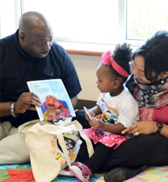
Trusted Messenger: Definition
Trusted Messenger:
Someone who is trusted by families and supports families by delivering messages and tools on early brain and language development.
You are granted the privilege of being a trusted messenger when you establish trust with the families you work with!
Notes:
Now, what exactly is a trusted messenger? Put simply, a trusted messenger is someone who is trusted by families and supports families by delivering messages and tools on early brain and language development. Trusted messengers can be anyone – a parent, a laundromat attendant, a doctor, a teacher, a cashier – you do not have to pass a test to be able to become a trusted messenger. Trusted messengers play a large role in our Talking is Teaching communities – trusted messengers are the ones who activate tools and resources, supporting and encouraging families in their journey as they raise their children.
However, it is important to note that you will not become a trusted messenger as a result of this training! Instead, you are GRANTED the privilege of being a trusted messenger when you establish trust with the families you work with.

Slide 39
Trusted Messenger: Etymology
TRUSTED MESSENGER
TRUST
MESSAGE
Notes:
If you look at the term "Trusted Messenger", you'll notice that it can be broken down into two ideas: TRUST and MESSAGE. Let's start off with the "Trust" half of the word. As I mentioned earlier, establishing trust with the families you work with is important to becoming a trusted messenger. So let's talk about building trust.

Slide 40
  3 Tips On Building Trust
Listen and Ask Questions
Empathize and Understand
Validate and Encourage
Notes:
While there are many ways to build trust with families, here are three starter tips, with ideas pulled from both the education and social work fields.
First, listen and ask questions. As you listen to the families' story, ask clarifying questions – this shows the family that you are actively engaged in what they have to say. And remember, listening means letting go of everything you think you already know about the family you're working with. We all show up in meetings or new relationships with assumptions about the person we're meeting. Before you meet with a new family, practice letting go of those assumptions so you're available to listen with fresh ears!
Second, empathize and understand. Every family is different, and every family has a different story. Work to empathize with and understand the positions, stories, and barriers the families may be facing. Put yourself in the shoes of the family.
Third, validate and encourage. After you listen to and empathize with the family, make sure to validate the work and effort they have put in. Let them know that all of their work so far has been integral to the development of their children. And be sure to be friendly and authentic - as I mentioned earlier, authenticity is key. Families will not want to open up to you if you are unwilling to be vulnerable and open yourself. Speak about your own experiences as a caregiver or parent and share both the struggles and joys of parenting!
Now, every trusted messenger is different, and the time that they have with the family may also vary. For example, a cashier will only have moments with the family, while a home visitor will have more time for one on one conversations. As such, depending on the trusted messenger, it may not be possible to fully build trust within the time that you speak with families. There may also not be time to do all three of these tips on the screen. In these moments, you don't have to stress about building trust or creating a strong relationship with the family – rather, look at step 3: validate and encourage! This is something that a trusted messenger can do in a short amount of time. A cashier could say "I know how difficult it is to be a parent. You're doing a great job." And this simple remark can validate the parent's work and effort.

Slide 41




You develop trust with families not by inviting them into your world; you develop trust by getting into their world.
Notes:
If you take away one thing from this training, I want it to be this: you develop trust with families not by inviting them into your world; you develop trust by getting into their world.

Slide 42
Trusted Messenger: Etymology
TRUSTED MESSENGER
TRUST
MESSAGE
Notes:
So, we talked about trust, and why it's such an important part of being a trusted messenger. Now, what about the "message" part?

Slide 43
Optional Slides:
Early Brain/Language Development
Notes:
The following slides can be used to dive deeper into the research of early brain and language development, as well as some slides on reading comprehension. A few of these slides were generously provided to us by Dr. Barry Zuckerman, founder of Reach Out and Read. You can pick and choose which visuals/slides you think participants would most benefit from, or create your own! An example of when these slides may be helpful to incorporate is with laundromat or grocery store attendants who may have not previously learned about the material.

Slide 44
REASEARCH
The Opportunity
Number of Words Learned
1200
Total Words
600
200
16
24
36
Child’s Age in Months
Child’s Age in Months
Source: Hart & Risley (1995)

Slide 45

What Predicts?
High School Graduation Rate
School Readiness
Early brain development
3rd Grade Reading
Source: HighScope Perry Preschool Study
Notes:
We also know that the early years can have a big impact, even later on in life. Interactions such as talking, reading, and singing builds the baby’s brain. This early brain development has an impact on preschool readiness, which in turn can impact 3rd grade reading levels, which then can even impact high school graduation rates.

Slide 46

Skills Required For Reading Comprehension
Decoding-breaking down words to letters and sounds
  CAT = K + A + T
Vocabulary-understanding what words mean
  CAT =
Slides from Dr. Barry Zuckerman – Promoting Early Literacy

Slide 47
Early Reading Ability:
Relationship to Decoding Skills
55% of variance in 1st grade reading is predicted by 2 skills related to decoding:
  print principles: naming letters, identifying sounds that go with letters
  phonemic awareness (ability to break down words into combinations of sounds)
Sources: Storch & Whitehurst, 2001; Bryant, 1990
Slides from Dr. Barry Zuckerman – Promoting Early Literacy

Slide 48
Literacy Guidance: Birth to 12 months
The parent/caregiver can
  cuddle with their baby as they read a book or tell a story
  point to and describe the book’s pictures: “Look, the train goes choo-choo!”
  use their voice, hands, and face to act out what they are reading and let the baby babble back in return
Source: Talking is Teaching: Talk, Read, Sing

Slide 49
Literacy Guidance: Young Toddlers 12 to 24 Months
The parent/caregiver can
  point and label objects in the book
  ask the child to identify common objects on the page —book, ball
  expand on the child's verbal initiatives —"yes, it’s a truck! good! it's a red truck!"
  use the book for a transition to bed or nap times
Source: Reach Out and Read

Slide 50
Literacy Guidance: Older Toddlers 24 to 36 Months
The parent/caregiver can
  make reading part of the days activities —such as pointing to stop signs
  relate the story in the text to the child —"you like to play ball too“
  give the child a chance to complete rhymes in a poem
  read a book at transitions such as nap times and bedtime.
Source: Reach Out and Read

Slide 51
Literacy Guidance: Preschoolers 3 to 5 Years
The parent/caregiver can
  let the child try to tell the story (while the parent is reading)
  ask "open-ended questions" such as "what do you think will happen next?"
  try to respond to the child's questions about the text as she reads
  the parent can point out letters of the child's name and make the sounds of the letters.
Source: Reach Out and Read

Slide 52


English as a Second Language
When possible, make books in the parents/caregivers first language available
Reassure families that in whatever language is most comfortable for them, reading aloud creates good associations with books and reading
Children who learn more than one language may begin to speak later, but ultimately their literacy levels will be higher

Slide 53
Research on Early Math
Children’s math knowledge at K-entry predicts 5th grade achievement in math and reading
Math knowledge gap at kindergarten entry for children from lower SES families
Early introduction to math talk helps children build STEM vocabularies and better prepares them for more advanced STEM topics
Claessens, Duncan, & Engel, 2009; Duncan et al., 2007
Denton & West, 2002
Kilbanoff, Levine, Huttenlocher, Vasilyeva, & Hedges, 2006
Notes:
Early math knowledge can have a substantial impact on school readiness and later school success
Before K, children are already building concepts and skills that form a critical foundation for the math they learn later in school
An increased appreciation of the richness and significance of children’s early mathematical experiences, along with an increased recognition of the importance of ensuring that children have access to these experiences.
As young a 3y, some kids already behind; kids who are behind when they enter K tend to stay behind; kids who enter kindergarten with better basic informal math skills tend to do better.
Early Childhood Longitudinal Study, Kindergarten Cohort (ECLS-K)
Identified over 20,000 children, nation-wide, at kindergarten entry; followed over half into elementary school.
ECLS-K study (Claessens et al): K-entry math prediction to 5th grade achievement held across SES subgroups. (reading and attention skills also predicted 5th grade achievement; social skills did not)
6 longitudinal data sets (Duncan et al): same results

Slide 54
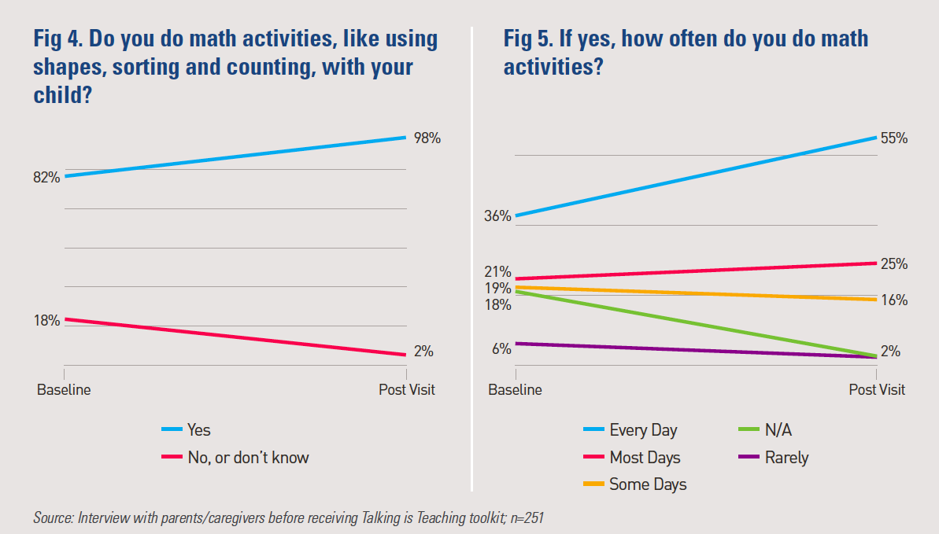
Talking is Teaching at UCSF BCHO
Early Math Evaluation Findings
Notes:
The most dramatic finding of the study showed that, 8 to 12 weeks after the initial visit, 55% of parents reported engaging in early math activities daily with their child, compared to 36% prior to the visit, representing a statistically significant difference. Additionally, prior to the visit, 18% of parents reported that they did not engage in any math activities with their child; 8-12 weeks after the visit, only 2% of parents reported that they did not engage in math activities with their child (see Figures 4 and 5).

Slide 55
Optional Slides:
Messaging
Notes:
The following slides include key messaging for both early math and social-emotional development. If you campaign is focusing on these topics, you can add these messages to your training.

Slide 56


Key Messages for Families – Early Math
Engage in “math talk” with your little one! Use words about numbers, shapes, relationships between or among objects, and patterns during your everyday routines and when reading!
You can talk about math anytime and anywhere! Count the number of carrots on a plate, compare the size of two toys, or find patterns on your clothes!

Slide 57
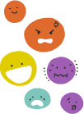
Key Messages for Families – SED
Strong social emotional development can boost your child’s learning!
Talk about your feelings and emotions! When children can name and identify their emotions, they are practicing emotional awareness.
Model self-regulation strategies: For big feelings, show clear ways to calm oneself (I.e. pause, taking deep breaths together)
Every child develops at their own pace.

Slide 58
Optional Slide:
Virtual Environments
Notes:
The following slide can be used to dive deeper into tips for a virtual environment, especially if trusted messengers will be engaging with families virtually

Slide 59
Tips for a Virtual Environment
When possible, chat via video. Eye contact can help build trust and connection.
Be personable. Share your own experience as a parent. Invite families to share theirs. Consider sharing photos or stories to "break the ice" and create a shared foundation for being connected.
Reassure families that you're not there to teach them anything. You're there to listen and offer support and encouragement.
Make it fun! Parents love connecting with other parents.
Acknowledge that the virtual environment is not ideal
Notes:
Now, some or all of you may be communicating with parents and caregivers over a virtual environment, whether this is by Zoom, FaceTime, or the phone. This can be difficult, so I want to briefly go over tips for how to engage families over a virtual environment.
First, when possible, chat via video. Eye contact can help build trust and connection. If the family you are working with does not have a video option, you have to rely on your voice, rather than nonverbal communication, to establish trust. Keep your tone and inflection bright and make sure that you give the family opportunities to talk.
Second, be personable. Share your own experience as a parent or caregiver, and invite families to share theirs. If possible, consider sharing photos or stories to "break the ice" and create a shared foundation for being connected. This is part of the important idea of being authentic and open.
Third, reassure families that you're not there to teach them anything. You're there to listen and offer support and encouragement. Remind them that they already have everything they need to be great parents.
Fourth, make it fun! This shouldn't be a lecture, demo, or lesson. Think of it instead as a meet-up for caregivers, where you can talk about successes and struggles and connect over the shared bond of being a caregiver.
Finally, acknowledge that the virtual environment is not ideal. I'm sure that you would all much rather be working with families in person face-to-face, just as I wish that this training could be in person! And speaking virtually definitely has its constraints. So acknowledge them! Tell the family that while speaking over Zoom or Skype or the phone isn't what you had hoped for, you're still there to support them and offer as much encouragement as you can.

Slide 60
Trusted Messenger Activity
Breakout rooms of 2. Switch roles after 10 minutes!
Person A
Person B
Talk about a moment where you really connected with an infant or young child. What was that like? What about the experience made you and the child light up?
​
Then, talk about an experience that didn't go so well, where you weren't connecting with a little one or you were unsure how to handle the situation. What was that like? How did you feel?​
Foster trust! Then, share one of the key messages and offer a concrete tool that your partner could use when spending time with young children in the future.​
​
Notes:
Note: If you are in a virtual-only environment, you could consider doing the Jamboard activity (this can also be done in person), but we’ve also had success with the following activity.
--------------------------------
[25 minutes] (20 minutes for breakout)
It's time for an activity! This activity will give you an opportunity to practice building trust as well as give you an opportunity to try to integrate the key messages and resources into conversations.
Person A will share one thing they really enjoy about spending time with young children and then one thing that they find difficult about spending time with young children.
Person B will share one of the key messages and offer a concrete tool that your partner could use when that difficult thing comes up again in the future.
Person B: Remember that your primary responsibility is building trust. Actively listen, empathize, validate, and/or encourage your partner before sharing a key Talking is Teaching message and offering a concrete tool.
The tool could be one that you know your community has or will be distributing for the Talking is Teaching campaign. If you don’t know which tools your community will be distributing, you can reference one you saw on our resource slide, or even make one up for this activity.
Model the activity briefly with a partner before putting participants into breakout rooms.
When you enter the breakout room, please feel free to take a minute or two to introduce yourselves! We will put the instructions into the chat a minute into the breakout rooms, as well as provide a notification on when to switch roles.
After returning from break out rooms [Grid-View]:
Thank you for your vulnerability in sharing with your partner. I'd love to hear from a few people on how that activity went.
* Did you learn something new? What didn't go so well, and what did you learn from that?
* How did integrating the early literacy messages and resources into the conversation feel? Was there anything you learned that you'd like to apply to future outreach with families?
After the discussion – still in grid mode
Thank you so much for sharing. Now, before we move on, I want to provide all of you with some insight and reasoning as to why we chose two activities for this training: the trust activity and the trusted messenger activity that you just did. The trust activity we did at the beginning, where you shared a story of who you trust, is important because it allows us to think about trust beyond a definition. Rather than just telling future trusted messengers to "foster trust", this activity gives us an insight into what qualities are important in a trusted messengers, which can then inform your own actions as a trusted messenger. This activity also allows us to be vulnerable and authentic from the very beginning of the training.
As for the activity we just did, we initially considered having a role play activity, where Person A would inhabit the role of an imaginary parent. But as we mentioned before, trusted messengers cannot go into a conversation with a preconceived notion or bias. We are entering their world, not the other way around. So, we strongly recommend that when you conduct a training, have an activity where participants really try to connect with one another and get into their world.

Slide 61
Optional Slide:
Impact of Messaging and Tools
Notes:
The following slide can be used to dive deeper into the impact of messaging and tools.

Slide 62
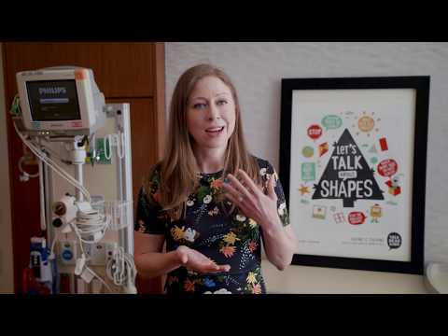
The Impact of Messaging and Tools
Notes:
So, we’re about to dive into some of the tools that the [CITY] campaign will be distributing to families, but before we do so, I thought that it might be helpful to share with you all the positive impact that messaging, tools, resources, and the trusted messenger can have. This video highlights pediatricians as trusted messengers at the San Francisco General Hospital. And while you may not be a pediatrician or working in a hospital setting, this video is a great example of how trusted messengers can integrate messaging and resource distribution into their everyday work, as well as showcasing the impact of messaging and tools.
Note to trainer: If you have a video of trusted messengers distributing tools and showcasing the impact, we encourage you to show that video instead!

Slide 63

To be honest, true honesty, this talk, read and sing is what got me to go and focus on these … with my kids. Because I'm the youngest out of four sisters. All my sisters have kids. They're all older, but they never taught me that you have to talk to your kids. You have to sing, read to them at a young age.
-Parent, about Talking is Teaching
Notes:
“To be honest, true honesty, this talk, read and sing is what got me to go and focus on these … with my kids. Because I'm the youngest out of four sisters. All my sisters have kids. They're all older, but they never taught me that you have to talk to your kids. You have to sing, read to them at a young age.”
So again, we’re seeing here the impact that a trusted messenger and their messaging can have.

Slide 64
Optional Slide:
Activities

Slide 65
Welcome Activity!
Pull a slip of paper from the hat
Without speaking, and humming only, find your partners
In your small group, share out why this work is important to you. Why are you here today?
Notes:
ESSENTIAL PREP: on a sheet of paper, type the names of four nursery rhymes, multiply this by the number of people you expect to attend. For example, if you have 20 people registered, type the four nursery rhymes 5 times. Then cut up into slips of paper, with one nursery ryhme printed on each slip of paper. Then, pour, and mix up the slips of paper in a hat.
Send the hat around for everyone to choose a slip of paper, and then begin the activity (as seen on slide)
After activity is over, invite everyone to return to their seats. Have one person share out from each group. Have them share what they said and ask them to share any similarities and differences from the group.
Have everyone take a seat.
Ask them how this activity made them feel – take a few responses.
Relate their feelings to the way parents/caregivers may feel when not knowing information, or if they are new to the neighborhood.

Slide 66
Activity time!
Activity Time!
Take a post-it from your table and write the first three words that come to mind when you think about the community you serve
Share out
Commonalities? Differences?
What sticks out the most? Why?
Notes:
Relate back to intro activity of humming – even though you couldn't speak the same language, there was something that you all recognized and identified with. Work with families' strengths!
Note: As the facilitator, pay attention to if the things mentioned are positive or negatives and bring this up. Anything that is discussed as a negative, be sure to frame it as a challenge, not a negative. If things take a negative tone overall, this will derail the constructive conversation.
After the share out:
You have many different people in your community, and you use different strategies to form relationships with each one. As you form relationships with community members, you: establish your role within the community, and potentially in their life; make community members aware of the resources you have to offer; and set the tone for the importance of building brain and language development of children in your neighborhood.

Slide 67

What Are Your Teachable Skills?
Think of one thing (it can be anything!) that you know REALLY well
  Can be work related, a talent you have, something you're passionate about, anything!
Find a partner
Start to teach them your thing
Share out
Notes:
How did you feel? As the facilitator? The learner? What were the challenges? What did you do to help the person understand?

Slide 68
Knowledge, Skills and Disposition
Around the room you will see 3 pieces of chart paper labeled Knowledge, Skills, and Disposition
As a group, add different items under each category that you need to be a successful facilitator of family engagement
Notes:
It is your job as a trusted messenger to understand this and use different modalities and strategies to connect with parent/caregivers to support them in being their child’s first teacher.

Slide 69

Welcome back
Welcome Back Activity
In small groups, you will count to 10 with your eyes closed
Each person can only say one number
If two people say the same number at the same time, you have to start over
Notes:
Be sure to mention that there’s no pre-planning!
What happened? Why? You need each other to continue, but you don't always know what's going on with each person. How does this apply to the work you do?

Slide 70
Closing Activity
What is one thing you've learned today?
What are one or two things you will take back and begin implementing right away?
Notes:
Have everyone stand in a circle and toss a skein of yarn or ball of string around the circle. Whoever has the string will share one thing they’ve learned and one thing they will begin implementing right away. When they toss the string/yarn to another participant, they hold on to a piece of it. In the end, you will have created a web! This web represents a connected community!

Slide 71


Types of Trusted Messenger Interactions

Slide 72
Extended Interaction
Short Interaction
Imagine the trusted messenger you want to partner with only has one or two minutes with a family (e.g. cashier during checkout, laundromat restaurant server, etc.).
What key message(s) and resource(s) would you encourage your trusted messenger to share?
How could they integrate this into their workflow?
Imagine the trusted messenger you want to partner with has a lot of time with a family
(e.g. librarian during story time, pediatrician, etc.)

